Slide 1

Presentation On Medicine Stock Management North Lakhimpur College(Autonomous)
Presented by-
Rahul kumar Sharma(20BC006)
Suban Kumar(20BC013)
Under the guidance of–
Mouchumi Dutta

Slide 2
Contents
Introduction
Advantages
ER-Diagram
RDBMS
Data flow diagram
Conclusion
Website design
Technologies
Reference

Slide 3
Introduction
A medical management system is a technology based solution design to help healthcare to manage medicine more efficiently.it provide health . The medical management system help healthcare providers and patients keep track of medication schedules, dosage, and prescription information. It can also provide medication reminders and alerts, medication reconciliation, and medication history. The project intends to solve the difficulties healthcare organizations experience in keeping sufficient levels of pharmaceuticals in store. The technology assists in preventing stockouts, reducing waste, and ensuring the availability of crucial pharmaceuticals for patients by automating vital operations and giving real-time visibility into inventories.

Slide 4
Purpose
The project's main purpose is to make healthcare institutions' pharmaceutical stock management more precise and effective. The following goals can be attained by healthcare organizations by applying this method. The drug Stock Management Project's overall goal is to provide a dependable and effective system that enables healthcare organizations to optimize drug stock levels, lower costs, enhance patient care, and make data-driven decisions for improved inventory management.

Slide 5
Scope
The following elements are included in the project's scope:
Medical practitioners can add new medications, update stock levels, monitor batch information, set reorder points, and get notifications when there are low supplies using the medicine inventory management system. It will offer a simple user interface to view and efficiently manage the drug inventory.
Management of Purchase Orders: The system will make it easier to create and monitor Purchase Orders for drugs. Users will be able to track order status, manage supplier information, and automate

Slide 6
Advantages
Improved inventory management: A medicine stock management website can help you keep track of your inventory levels, ensuring that you always have the right amount of medicine in stock. This can help you avoid stockouts or overstocking, which can lead to lost sales or waste.
Increased efficiency: With a medicine stock management website, you can automate many of the tasks involved in managing your inventory, such as tracking expiration dates, generating reports, and reordering products. This can save you time and reduce the risk of errors.
Regulatory compliance: A medicine stock management website can help you stay compliant with regulatory requirements, such as tracking the lot and batch numbers of products and maintaining accurate records of inventory movements.

Slide 7
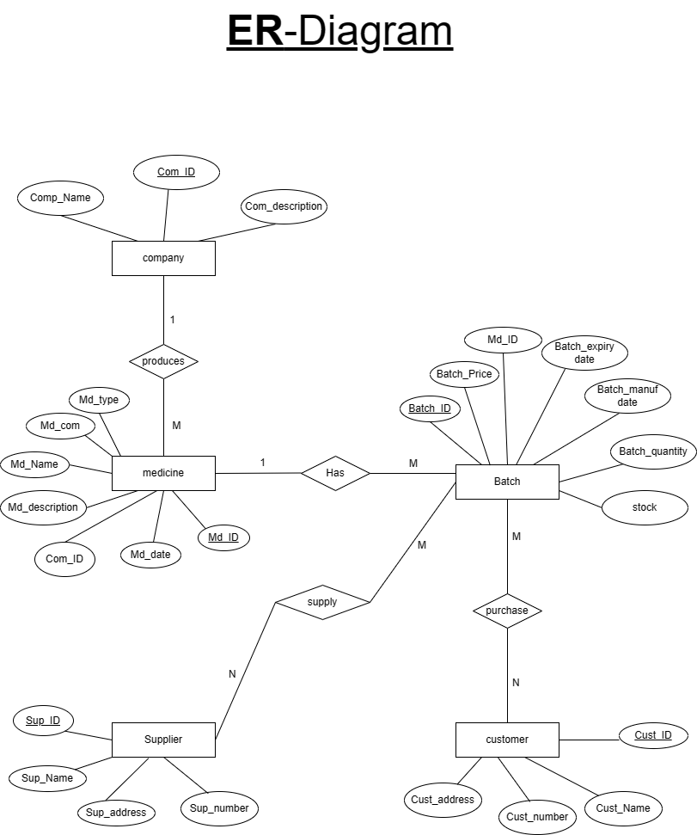
ER-Diagram

Slide 8
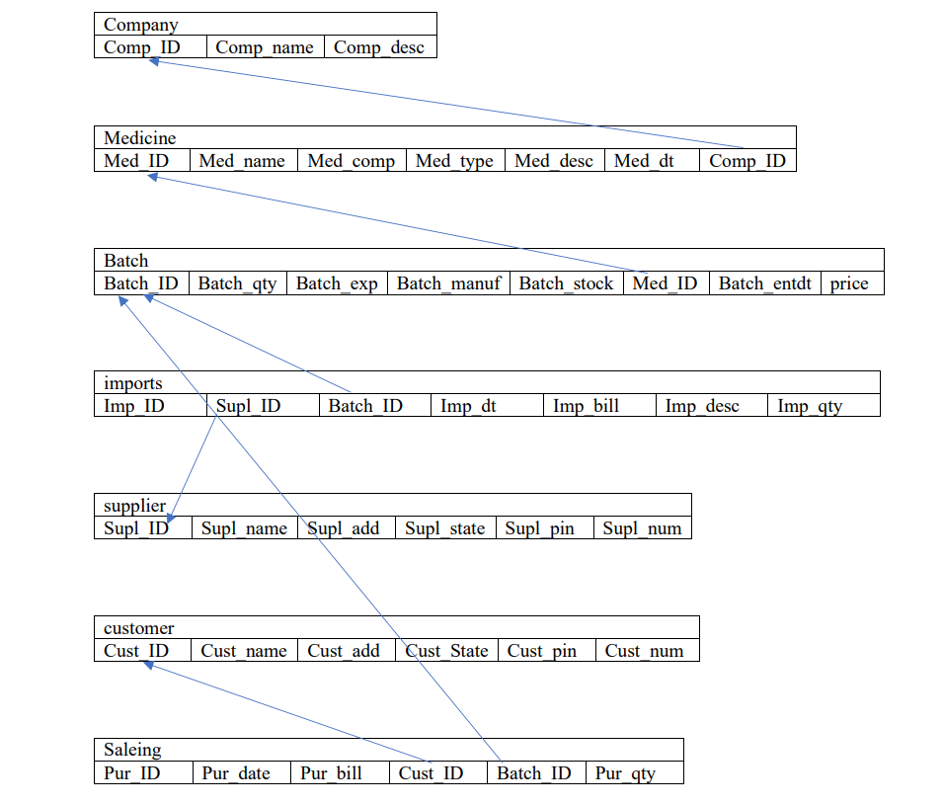
RDBMS

Slide 9
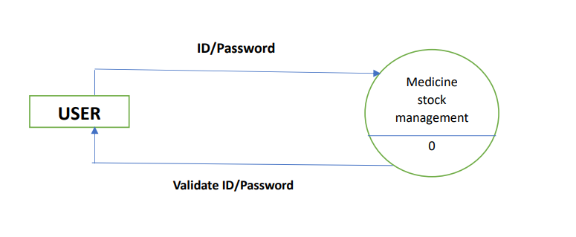
Data flow diagram
Level-0

Slide 10
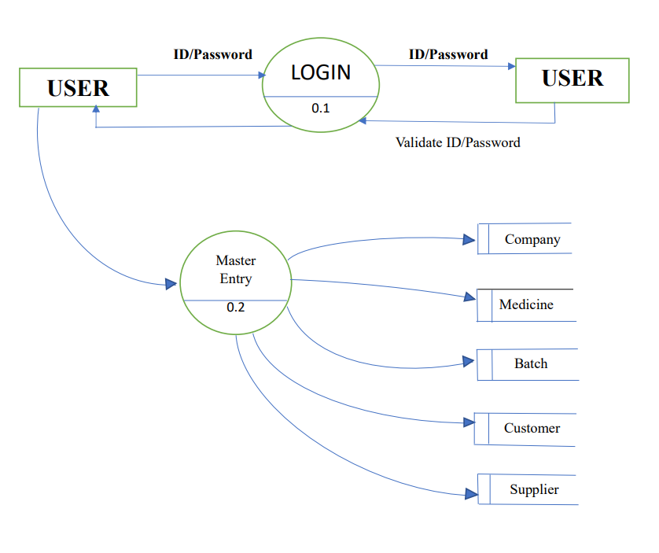
Level-1

Slide 11
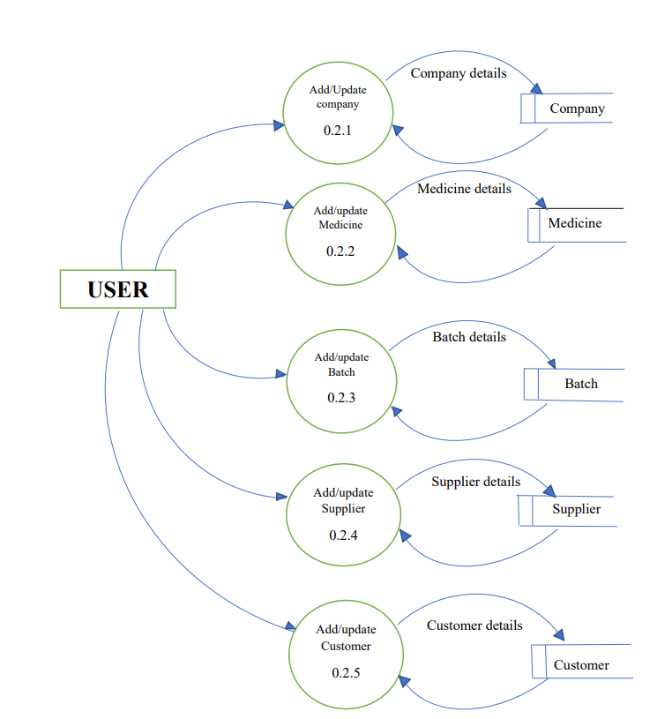
Level-2

Slide 12
Conclusion
The Medicine Stock Management Project, is a complete software program created to simplify the management and monitoring of drug inventory in healthcare institutions. The project intends to solve the difficulties that healthcare professionals encounter in efficiently controlling drug stock levels, streamlining the procurement procedure, monitoring sales and billing, and producing informative reports for data-driven decision-making. The system consists of numerous modules that allow users to carry out crucial operations such managing the inventory of medications, managing purchase orders, managing sales and billing, and reporting and analytics.

Slide 13
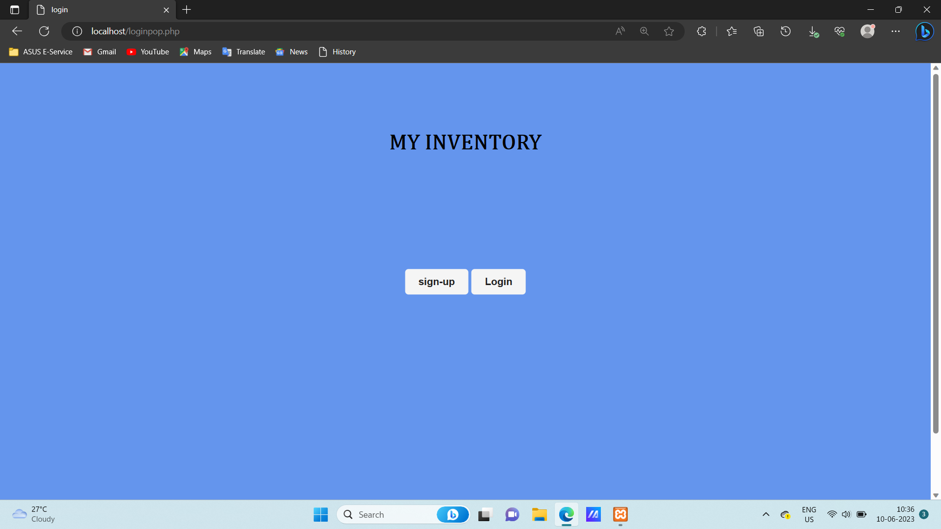
Website Design

Slide 14
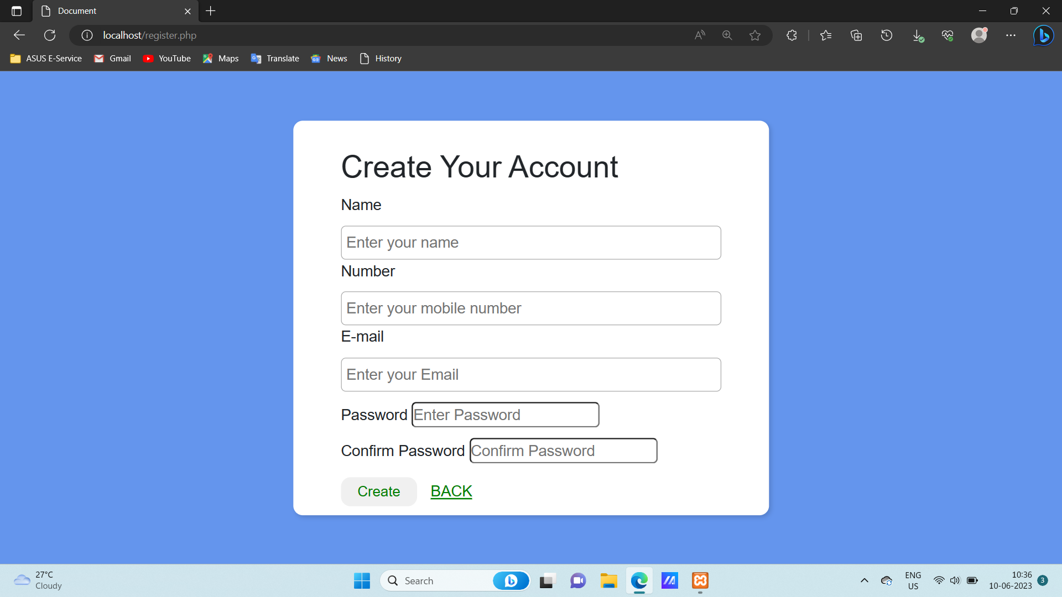
Register page

Slide 15
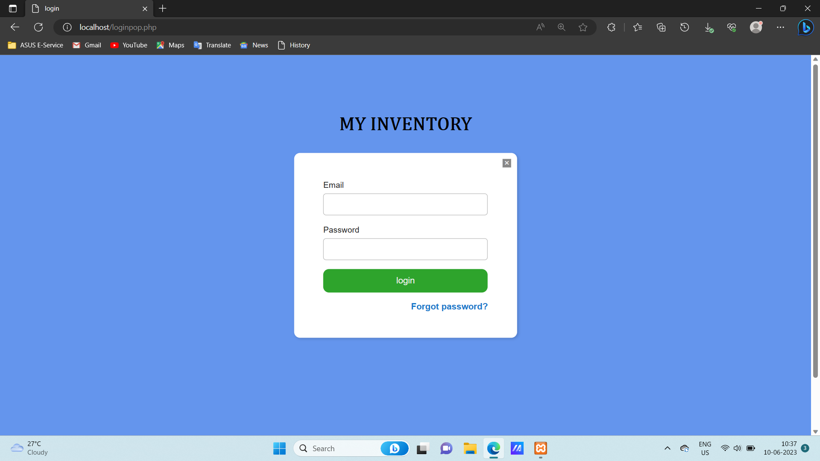
Login page

Slide 16
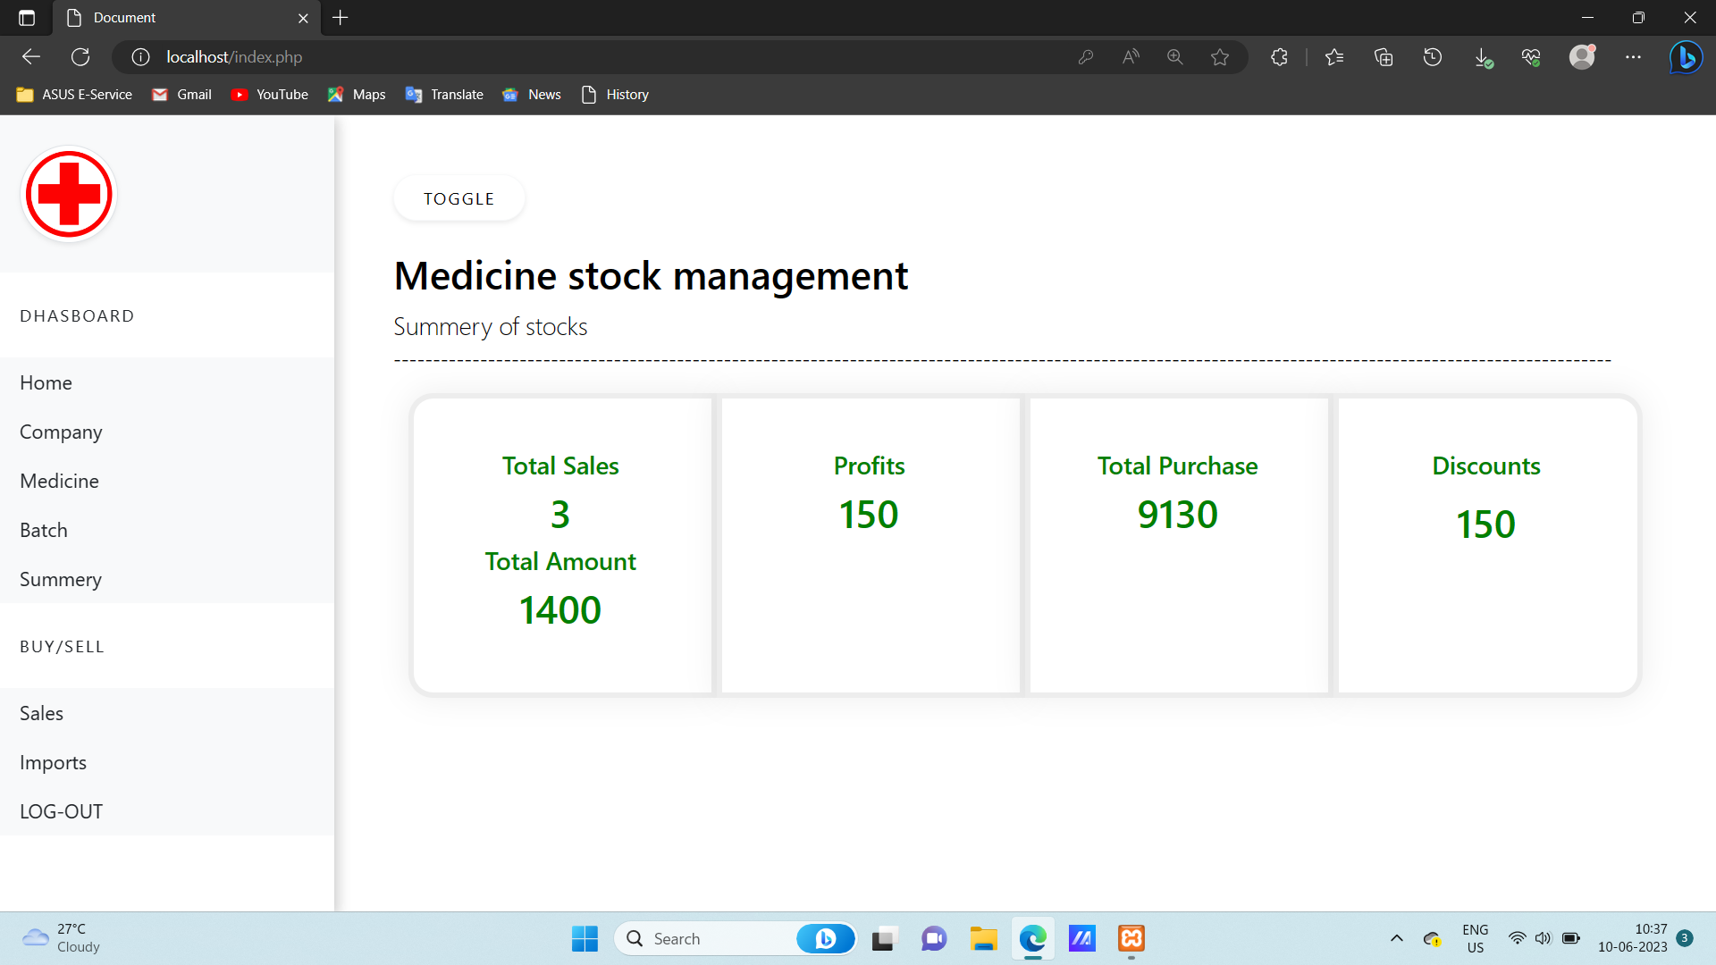
Dashboard

Slide 17
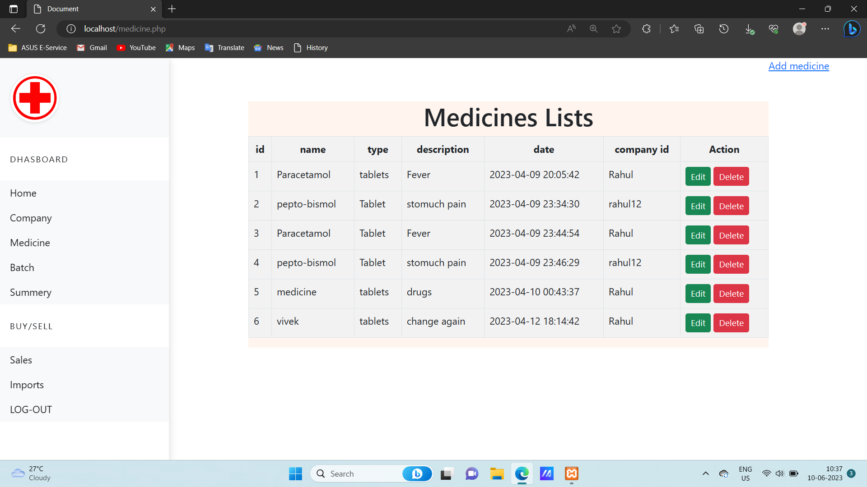
Medicine page

Slide 18
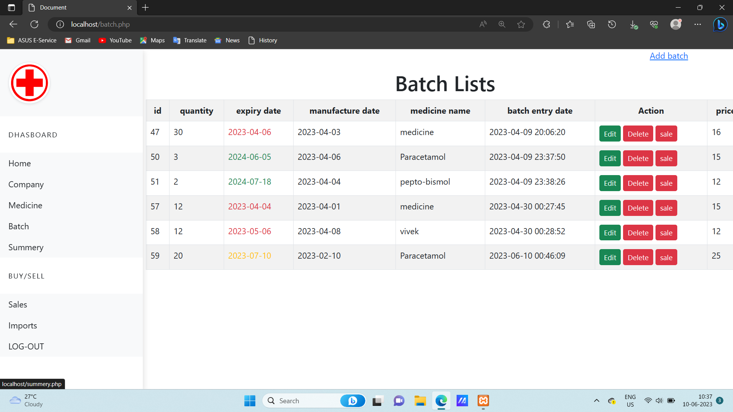
Batch page

Slide 19
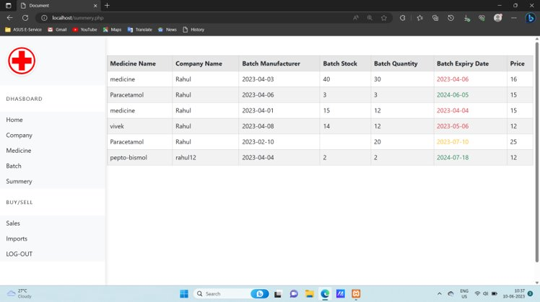
summary

Slide 20
Technologies used in website
Front-End Technologies
HTML and CSS
Front-End Frameworks and Libraries
Bootstrap
Back-End Technologies
PHP , JavaScript and J query

Slide 21
Reference
Geeksforgeeks
YouTube
Google
ChatGPT

Slide 22
Thank you

